Slide 1

TIME Series Analysis
Popularity of Air Conditioners and Heaters

Slide 2
Dataset
Our dataset is made up of Google Trends data on the monthly world-wide popularity of air conditioners and heaters from January 2005 to October 2023. By popularity, we mean the number of web searches for these two items that occurred over the given time period.

Slide 3
Google Trends
Google Trends is a useful search trends feature that displays how frequently a given search term is entered into Google's search engine in comparison to the site's total search volume over a specified time period. Numbers on the graph don't represent absolute search volume numbers, because the data is normalized and presented on a scale from 0-100

Slide 4
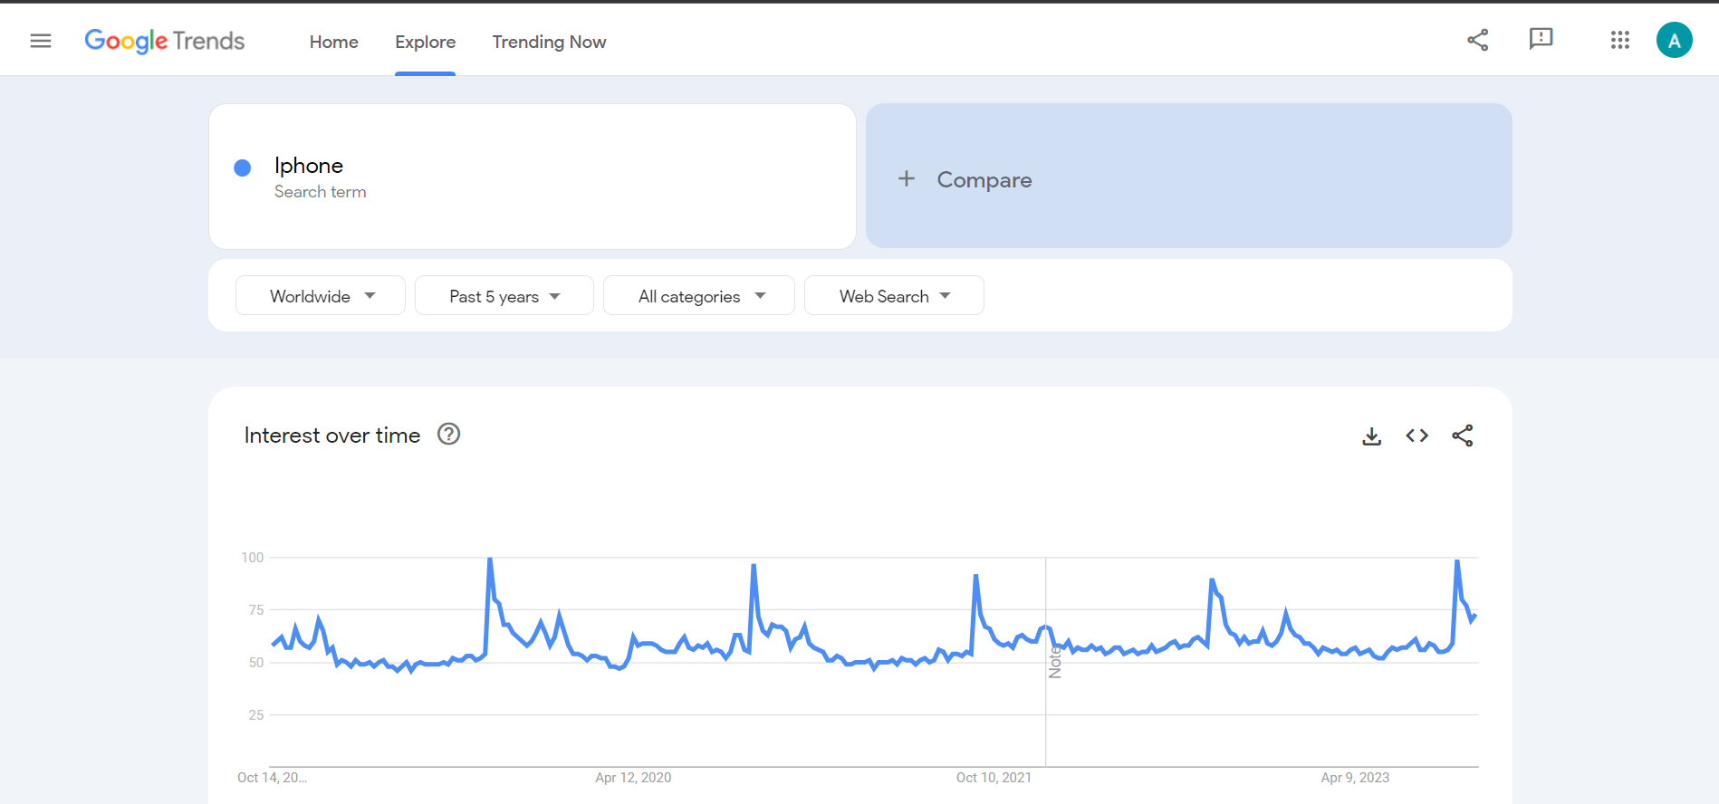
Google Trends

Slide 5
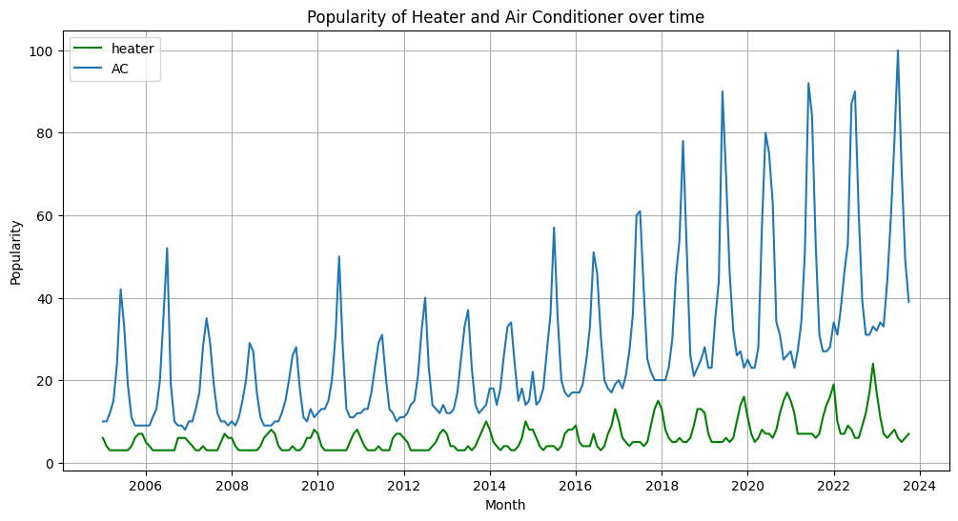
Visualization
Notes:
Describe the plot. Pointers: Heaters max corresponds to AC’s highest vice versa. Increasing trend reasons could be more access to google, online shopping, global warming. Heater is lower than AC probably cause of the data , Next Slide why

Slide 6
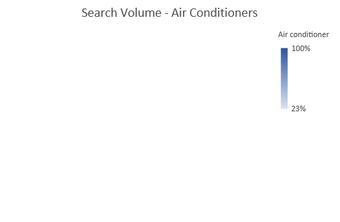
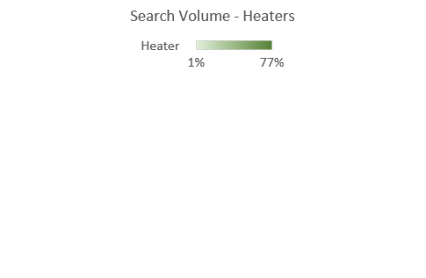
Popularity based on Country
Countries near the equator search more frequently about ACs while the farthest from equator search more about heaters. US, Canada, Australia generally have very cold winters and thus maybe heaters are more frequently searched than Acs
Notes:
Pointers: No data on European countries and countries closer to the pole, they usually have very cold winters. Most of the data is from countries that are generally hotter in temperature

Slide 7
Motivation
A time series consists of various components like trends, seasonality, irregular fluctuations. Trends can result in a varying mean over time, whereas seasonality can result in a changing variance over time, both which define a time series as being non-stationary. Stationary datasets are those that have a stable mean and variance, and are in turn much easier to model.
Key Points:
Seasonal Influences: Seasonal fluctuations significantly impact the popularity of "Heater" and "AC." These patterns may be reflective of changing climate conditions and consumer behaviors.
Trend Identification: We seek to identify any long-term trends that have emerged over the years, shedding light on the evolving consumer preferences for these appliances.

Slide 8
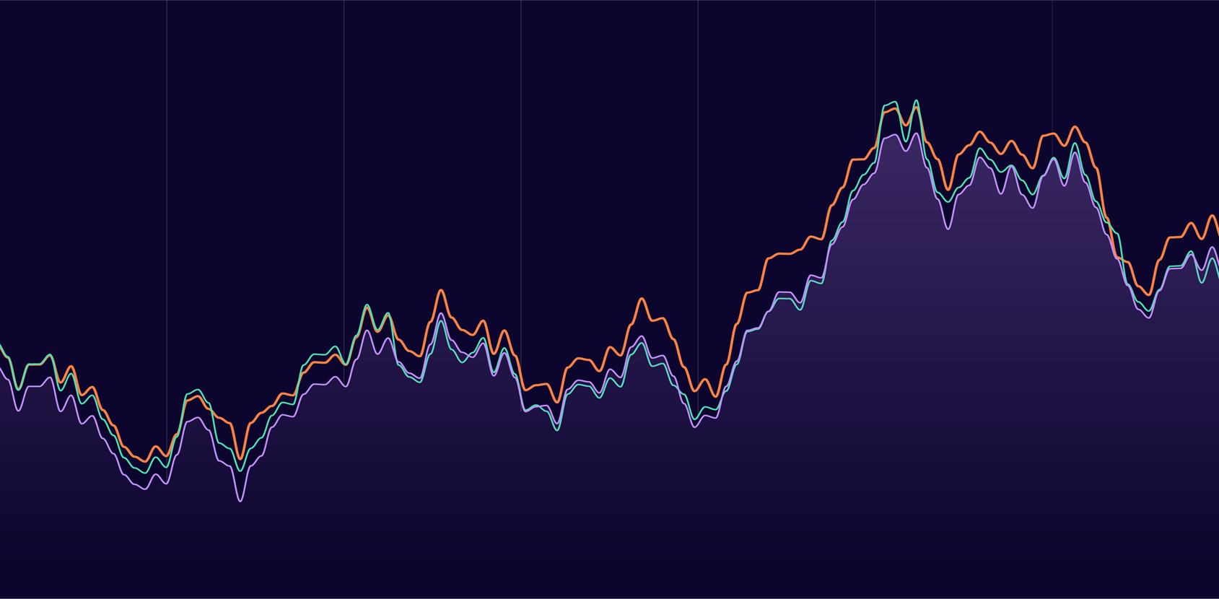
Estimating Trend and Seasonality
Parametric Methods
Non-Parametric Methods

Slide 9
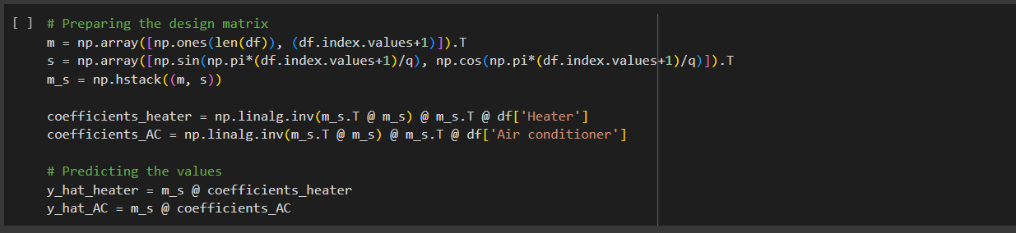
Model:
X_{t} = a₀ + a₁t+b₁sin(πt/6) +c₁cos(πt/6)
Here, m_{t} = a₀ + a₁t corresponds to the trend of popularity over the years
And, s_{t} = b₁sin(πt/6) + c₁cos(πt/6) corresponds to the seasonal effects of the popularity.
Estimation:
By the differentiating the residual sum of squares we can estimate the coefficients as
𝝱 = (B^{T}B)⁻¹ B^{T}X
Where, 𝝱 = [a₀, a₁, b₁, c₁]^{T}
B_{i} = [ 1, i, cos(πi/6) , sin(πi/6) ] for i = 1,2,...,n
Parametric
Multiple Linear Regression
Notes:
Multiple Regression is a statistical technique used to model the relationship between a dependent variable (in this case, the popularity of "Heater" and "AC") and multiple independent variables (in this case: t, sin(𝜋t/6), cos(𝜋t/6),

Slide 10
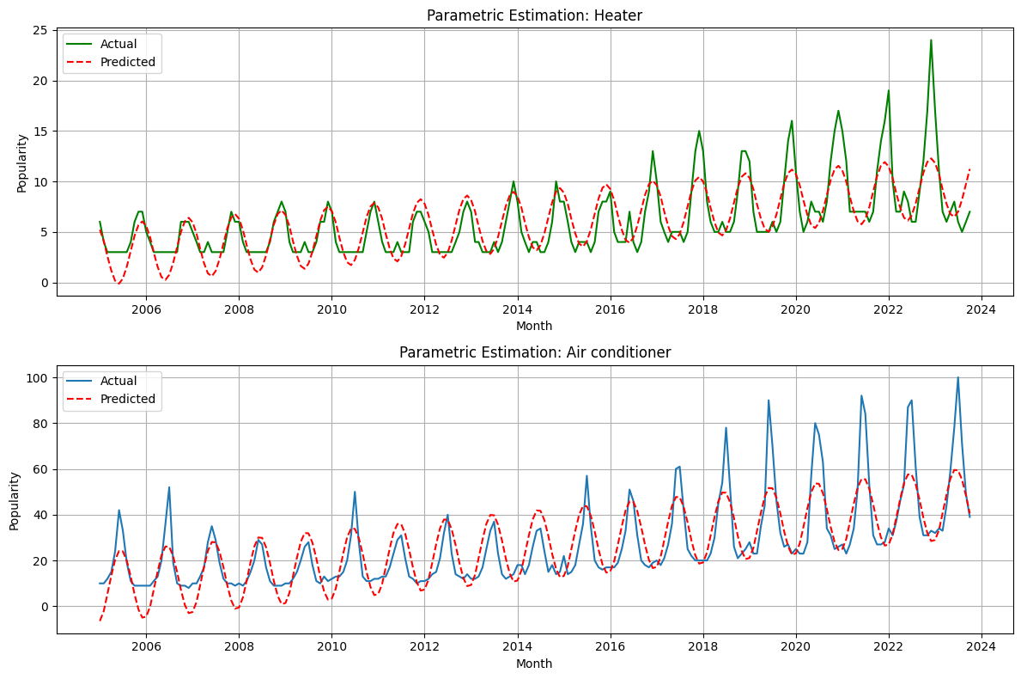
Coefficients:
𝝱 = [2.68 0.03 -0.16 2.99]
RMSE: 2.01
Parametric
Multiple Linear Regression
Coefficients:
𝝱 = [8.12 0.16 -3.4 -15.04]
RMSE: 10.08
Notes:
Interpret Plot

Slide 11
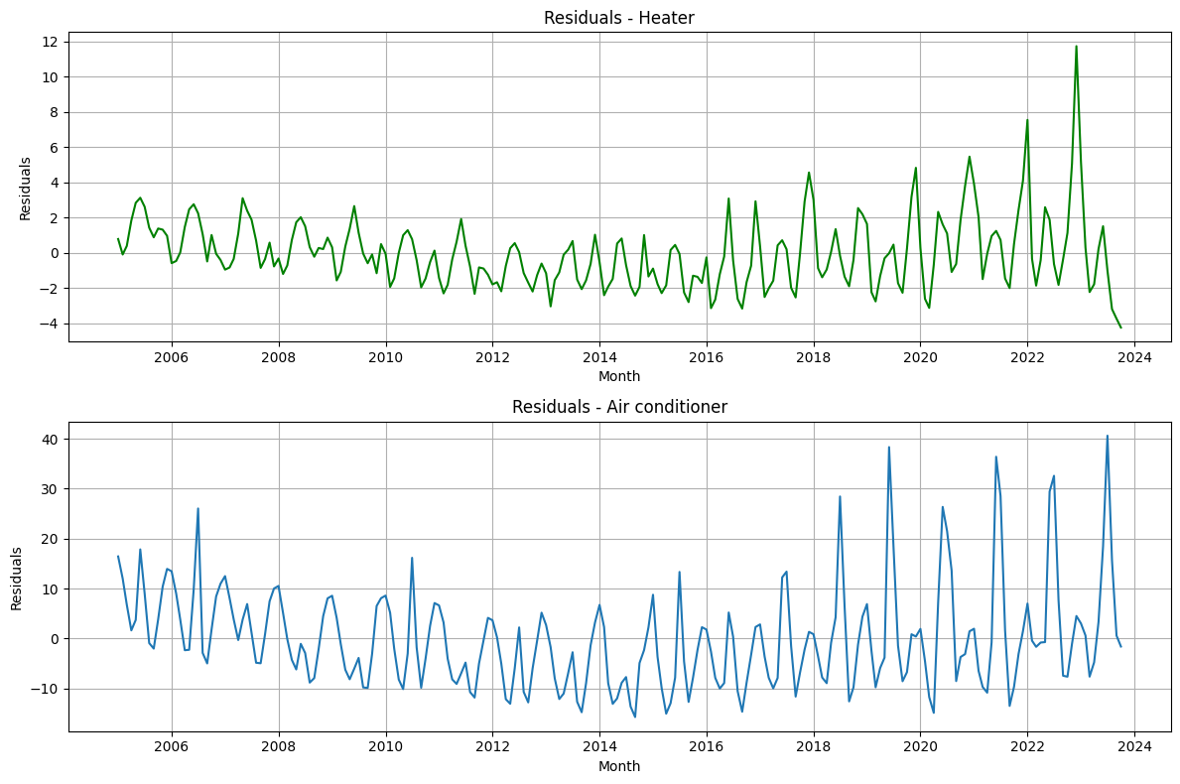
Parametric
Multiple Linear Regression
Notes:
Interpret Plot. Pointers: Still some trend and seasonality visible

Slide 12
Non-Parametric Estimation
Moving Average Filter: Estimate Trend
Moving Average Filter: Estimate Seasonality
To estimate the trend of the data, moving average filter is applied. The trend component m_{t} is estimated as:
m_{t} = (0.5*x_{t-q} + x_{t-q-1} + ……..+ x_{t+q-1} + 0.5*x_{t+q})/d
where , d = 2q and q < t ≤ n - q.
Since we are analyzing monthly data across the years, d =12 and hence q = 6.
We estimate the seasonal component using the trend obtained from moving average filter. We calculate the average of each month across the years
w_{k} = average( x_{k+jd} - m_{k+jd} )
where k=1,2,…,d and q < k +jd ≤ n - q
Now, estimating the seasonal component as
s_{k} = w_{k} - (𝜮_{i=1}^{k} w_{i})/d
where k=1,2,…,d

Slide 13
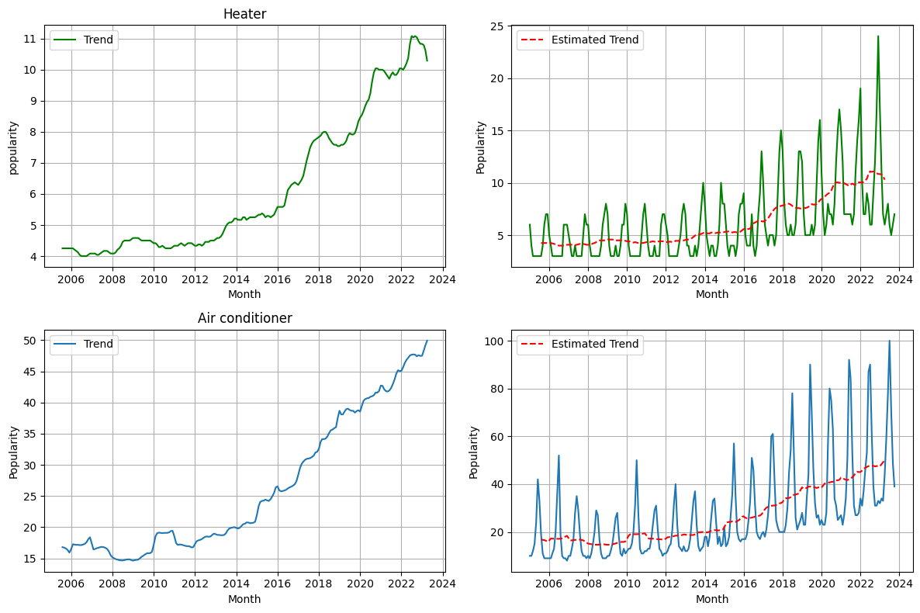
Moving Average Filter
Trend Estimation
Notes:
Interpret Plot

Slide 14
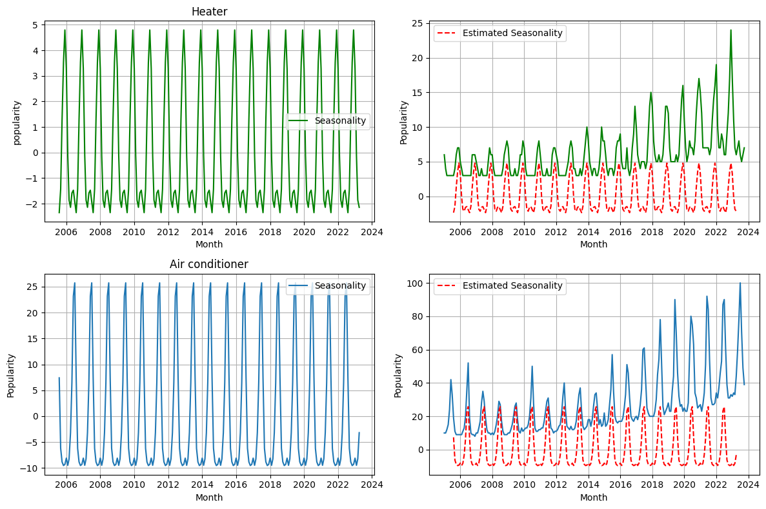
Moving Average Filter
Seasonality Estimation
Notes:
Interpret Plot

Slide 15
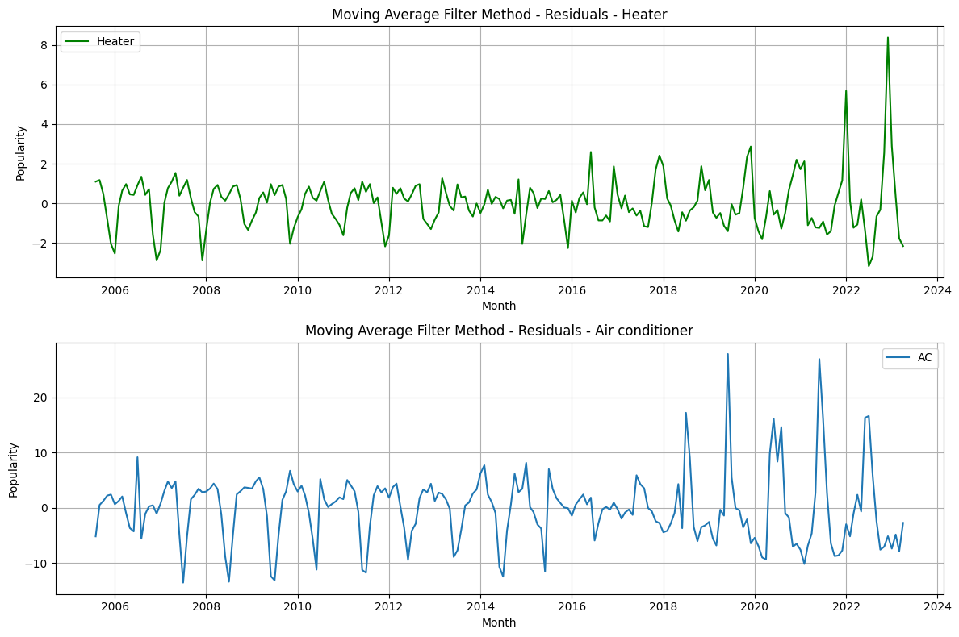
Moving Average Filter
Residuals
Notes:
Interpret. Pointers: There might be seasonality in the data

Slide 16
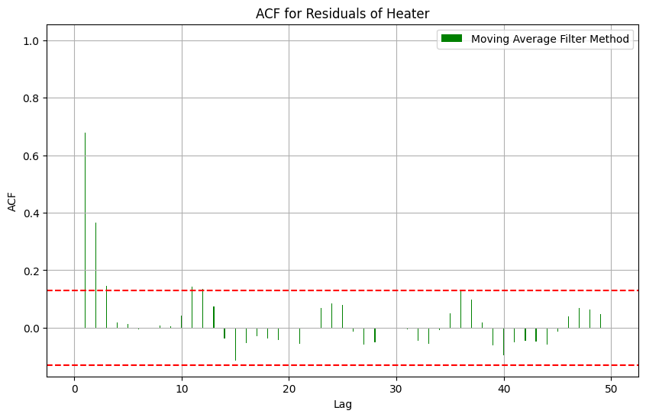
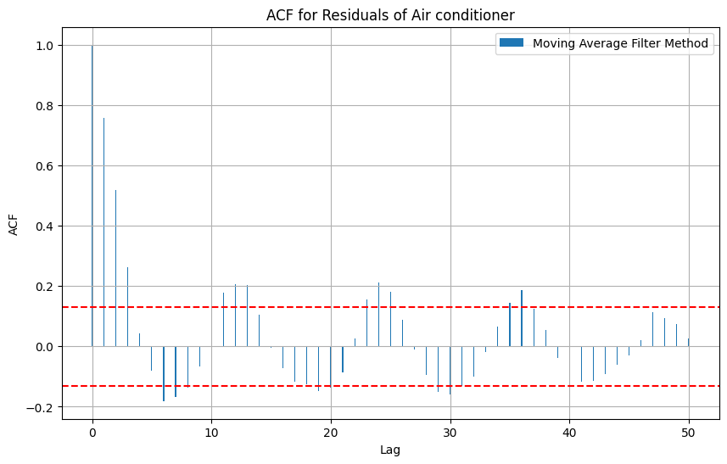
Interpretation:
ACF at h = 1, 2 are the only significant lags while the rest are zero , suggesting that the underlying process is stationary and is most likely to be a moving average of order 2.
Moving Average Filter
Autocorrelation Function
Interpretation:
ACF is gradually decreasing suggesting our process could be Auto regressive process however its seasonally repeating after around 5 lags, it suggests there might be some seasonality.

Slide 17
Non-Parametric Estimation
Method of Differencing to remove trend and Seasonality
Instead of estimating trend, seasonality and subtracting them from original, we can use the differencing operator to directly estimate the residual of a time series.
Residual can be estimated as:
∇_{d} X_{t} = (m_{t} - m_{t-d}) + ( Y_{t} - Y_{t-d}) = a₁d + (Y_{t} - Y_{t-d})
Where,
X_{t} = m_{t} + s_{t} + Y_{t}, where m_{t} = a₀ + a₁t (trend component), s_{t} is the seasonal component and Y_{t} is the residual term.

Slide 18
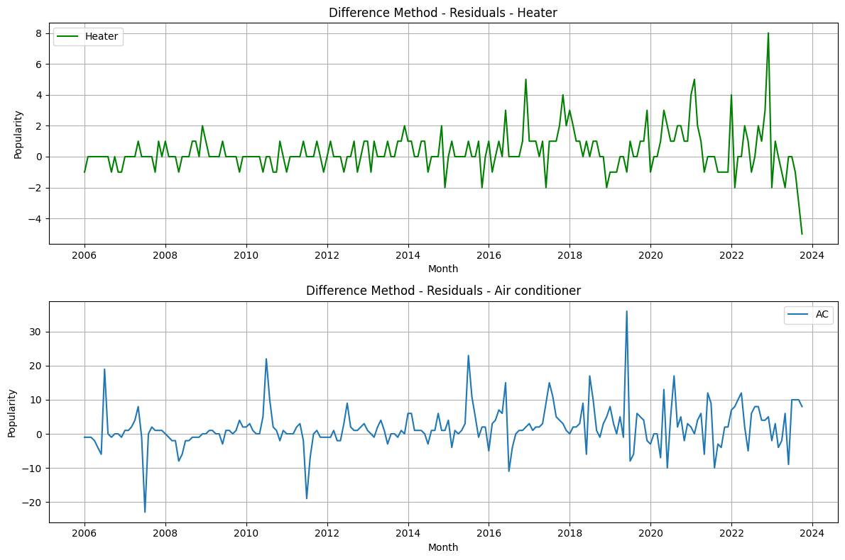
Method of Differencing
Residuals
Notes:
Interpret Results

Slide 19
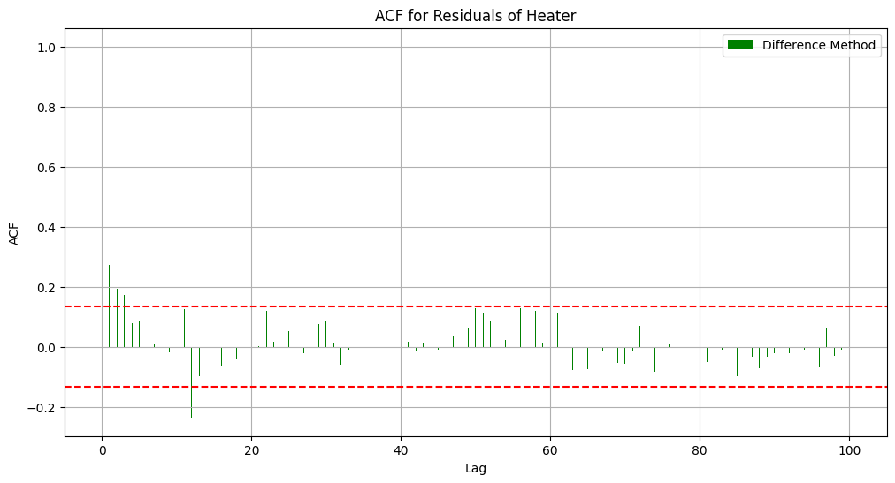
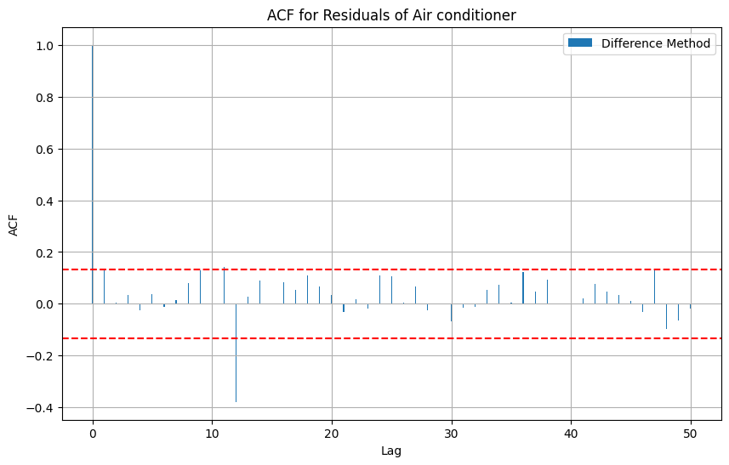
Interpretation:
Process is most likely stationary. The underlying process can be a moving average process of order 2 or 3 as lag at approximately 3 points seems to be significantly not equal to 0.
Method of Differencing
Autocorrelation Function
Interpretation:
Process is most likely stationary. There is a lag significantly not equal to 0, the process is likely to be Moving Average of order 1

Slide 20
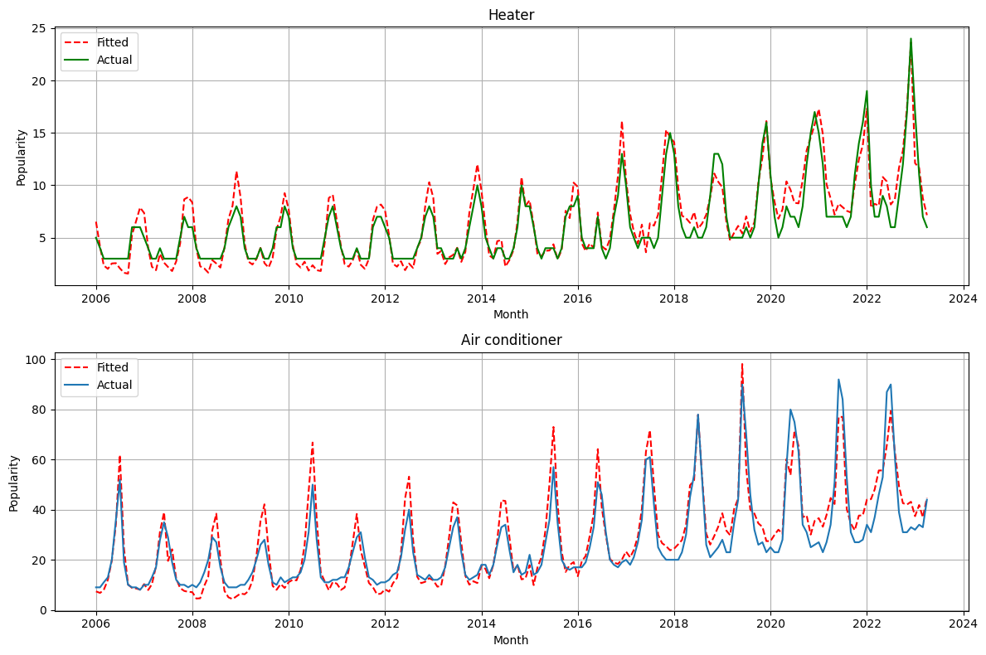
Fitting
RMSE: 1.29
Adjusted R2: 0.87
RMSE: 6.55
Adjusted R2: 0.85

Slide 21

Conclusion
We estimate the time series for the heater and air conditioner dataset using parametric and non-parametric methods. The parametric approach is unable to model real-world data effectively. It fails to capture the increasing seasonal fluctuations for both datasets. Using the non-parametric approach to estimate the time series for the heater and air conditioner dataset, we obtained more than 85% explanation in variance. Differencing seems to be the superior method of estimation in this case as the auto-correlogram shows that the noise estimated by differencing has almost no cyclic fluctuations in the non-significant values. The underlying noise is stationary, we can estimate the trend and seasonal fluctuations in any time series and effectively evaluate that series.

Slide 22
Thank you
Done by: Group-4
Anita Dash
Karthik Kurugodu
Tanay Yadav
N.Dilip Kumar Reddy

